Slide 1
SOFTWARE ENGINEERING
Introduction to
Unified Modeling Language (UML)
Heavily based on UML Slides made available at following locations:
https://www.cs.drexel.edu/~spiros/teaching/CS575/slides/uml.ppt
https://www.cs.ucf.edu/~turgut/COURSES/EEL5881_SEI_Fall07/UML_Lecture.ppt

Slide 2
WHAT IS UML AND WHY WE USE UML?
UML → “Unified Modeling Language”
Modeling: Describing a software system at a high level of abstraction
Unified: UML has become a world standard
Object Management Group (OMG): www.omg.org
It is a industry-standard graphical language for specifying, visualizing, constructing, and documenting the artifacts of software systems
The UML uses mostly graphical notations to express the OO analysis and design of software projects.
Simplifies the complex process of software design

Slide 3
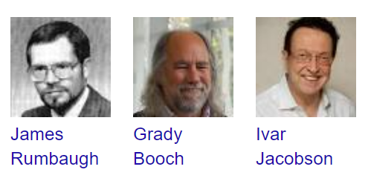
UML: UNIFIED MODELING LANGUAGE
Developed by the “Three Amigos”: Grady Booch, Jim Rumbaugh, Ivar Jacobson in 1994-85 at Rational Software
  Each had their own development methodology
  More or less emphasis on notation and process
UML is a notation and a process
  Diagrams and notation from UML 1.3 Definition (http://www.rational.com)

Slide 4
DIAGRAMS
Class diagrams: Represent static structure
Use case diagrams: Sequence of actions a system performs to yield an observable result to an actor
Sequence diagrams: Show how groups of objects interact in some behavior
State diagrams: Describe behavior of system by describing states of an object
Activity diagrams: Activity diagram is a flowchart to represent the flow from one activity to another activity
Collaboration diagrams: Show the message flow between objects in an OO application, and also imply the basic associations (relationships) between classes

Slide 5
CLASSES
ClassName
A class is a description of a set of
objects that share the same attributes,
operations, relationships, and semantics.
Graphically, a class is rendered as a
rectangle, usually including its name,
attributes, and operations in separate,
designated compartments.
attributes
operations

Slide 6
CLASS NAMES
ClassName
The name of the class is the only required tag in the graphical representation of a class. It always appears in the top-most compartment.
attributes
operations

Slide 7
CLASS ATTRIBUTES
Person
name : String
address : Address
birthdate : Date
ssn : Id
An attribute is a named property of a
class that describes the object being modeled.
In the class diagram, attributes appear in
the second compartment just below the
name-compartment.

Slide 8
CLASS ATTRIBUTES (CONT’D)
Person
Attributes are usually listed in the form:
attributeName : Type
A derived attribute is one that can be
computed from other attributes, but
doesn’t actually exist. For example,
a Person’s age can be computed from
his birth date. A derived attribute is
designated by a preceding ‘/’ as in:
/ age : Date
name : String
address : Address
birthdate : Date
/ age : Date
ssn : Id

Slide 9
CLASS ATTRIBUTES (CONT’D)
Person
+ name : String
# address : Address
# birthdate : Date
/ age : Date
- ssn : Id
Attributes can be:
+ public
# protected
- private
/ derived

Slide 10
CLASS OPERATIONS
Person
name : String
address : Address
birthdate : Date
ssn : Id
eat
sleep
work
play
Operations describe the class behavior
and appear in the third compartment.

Slide 11
CLASS OPERATIONS (CONT’D)
PhoneBook
newEntry (n : Name, a : Address, p : PhoneNumber, d : Description)
getPhone ( n : Name, a : Address) : PhoneNumber
You can specify an operation by stating its signature: listing the name, type, and default value of all parameters, and, in the case of functions, a return type.

Slide 12
DEPICTING CLASSES
When drawing a class, you needn’t show attributes and operation in every diagram.
Person
Person
Person
name : String
birthdate : Date
ssn : Id
Person
name
address
birthdate
eat()
sleep()
work()
play()
Person
eat
play

Slide 13
CLASS RESPONSIBILITIES
A class may also include its responsibilities in a class diagram.
A responsibility is a contract or obligation of a class to perform a particular service.
SmokeAlarm
Responsibilities
-- sound alert and notify guard station
when smoke is detected.
-- indicate battery state

Slide 14
RELATIONSHIPS
In UML, object interconnections (logical or physical), are
modeled as relationships.
There are three kinds of relationships in UML:
  dependencies
  generalizations
  associations

Slide 15
DEPENDENCY RELATIONSHIPS
A dependency indicates a semantic relationship between two or
more elements. The dependency from CourseSchedule to Course exists because Course is used in both the add and remove operations of CourseSchedule.
CourseSchedule
Course
add(c : Course)
remove(c : Course)

Slide 16
GENERALIZATION RELATIONSHIPS
Person
A generalization connects a subclass
to its superclass. It denotes an
inheritance of attributes and behavior
from the superclass to the subclass and
indicates a specialization in the subclass
of the more general superclass.
Supertype
Student
Subtype1
Subtype2

Slide 17
GENERALIZATION RELATIONSHIPS (CONT’D)
UML permits a class to inherit from multiple superclasses, although some programming languages (e.g., Java) do not permit multiple inheritance.
Student
Employee
TeachingAssistant

Slide 18
ASSOCIATION RELATIONSHIPS
If two classes in a model need to communicate with each other, there must be link between them.
An association denotes that link.
Student
Instructor

Slide 19
ASSOCIATION RELATIONSHIPS (CONT’D)
We can indicate the multiplicity of an association by adding multiplicity adornments to the line denoting the association.
The example indicates that a Student has one or more Instructors:
Student
Instructor
1..*

Slide 20
ASSOCIATION RELATIONSHIPS (CONT’D)
The example indicates that every Instructor has one or more Students:
Student
Instructor
1..*

Slide 21
ASSOCIATION: MULTIPLICITY AND ROLES
student
1
*
University
Person
0..1
*
employer
teacher
Multiplicity
Symbol Meaning
1 One and only one
0..1 Zero or one
M..N From M to N (natural language)
* From zero to any positive integer
0..* From zero to any positive integer
1..* From one to any positive integer
Role
Role
“A given university groups many people; some act as students, others as teachers. A given student belongs to a single university; a given teacher may or may not be working for the university at a particular time.”

Slide 22
ASSOCIATION: MODEL TO IMPLEMENTATION
*
4
Student
Course
has
enrolls
Class Student {
Course enrolls[4];
}
Class Course {
Student have[];
}

Slide 23
ASSOCIATION RELATIONSHIPS (CONT’D)
We can also indicate the behavior of an object in an association (i.e., the role of an object) using rolenames.
teaches
learns from
Student
Instructor
1..*
1..*

Slide 24
ASSOCIATION RELATIONSHIPS (CONT’D)
We can also name the association.
membership
Student
Team
1..*
1..*

Slide 25
ASSOCIATION RELATIONSHIPS (CONT’D)
We can specify dual associations.
member of
Student
Team
1..*
1..*
1
president of
1..*

Slide 26
ASSOCIATION RELATIONSHIPS (CONT’D)
We can constrain the association relationship by defining the navigability of the association. Here, a Router object requests services from a DNS object by sending messages to (invoking the operations of) the server. The direction of the association indicates that the server has no knowledge of the Router.
Router
DomainNameServer

Slide 27
ASSOCIATION RELATIONSHIPS (CONT’D)
Associations can also be objects themselves, called link classes or an association classes.
Registration
modelNumber
serialNumber
warrentyCode
Product
Warranty

Slide 28
ASSOCIATION RELATIONSHIPS (CONT’D)
A class can have a self association.
next
LinkedListNode
previous

Slide 29
ASSOCIATION RELATIONSHIPS (CONT’D)
We can model objects that contain other objects by way of special associations called aggregations and compositions.
An aggregation specifies a whole-part relationship between an aggregate (a whole) and a constituent part, where the part can exist independently from the aggregate. Aggregations are denoted by a hollow-diamond adornment on the association.
Car
Engine
Transmission

Slide 30
OO RELATIONSHIPS: AGGREGATION
Container Class
Aggregation:
expresses a relationship among instances of related classes. It is a specific kind of Container-Containee relationship.
express a more informal relationship than composition expresses.
Aggregation is appropriate when Container and Containees have no special access privileges to each other.
Class C
AGGREGATION
Class E₁
Class E₂
Containee Classes
Example
Bag
Apples
Milk

Slide 31
ASSOCIATION RELATIONSHIPS (CONT’D)
A composition indicates a strong ownership and coincident lifetime of parts by the whole (i.e., they live and die as a whole). Compositions are denoted by a filled-diamond adornment on the association.
Window
Scrollbar
1
1
Titlebar
1
1
Menu
1
1 .. *

Slide 32
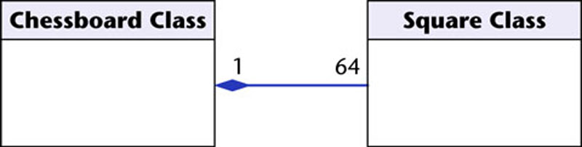
OO Relationships: Composition
Class W
Association
  Models the part–whole relationship
Composition
  Also models the part–whole relationship but, in addition, Every part may belong to only one whole, and If the whole is deleted, so are the parts
Example:
A number of different chess boards: Each square belongs to only one board. If a chess board is thrown away, all 64 squares on that board go as well.
Whole Class
Class P₁
Class P₂
Part Classes
Example
Figure 16.7
The McGraw-Hill Companies, 2005

Slide 33
AGGREGATION VS. COMPOSITION
  Composition is really a strong form of association
  components have only one owner
  components cannot exist independent of their owner
  components live or die with their owner
  e.g. Each car has an engine that can not be shared with other cars.
  Aggregations
  may form "part of" the association, but may not be essential to it. They may also exist independent of the aggregate. e.g. Apples may exist independent of the bag.

Slide 34
INTERFACES
An interface is a named set of operations that specifies the behavior of objects without showing their inner structure. It can be rendered in the model by a one- or two-compartment rectangle, with the stereotype <<interface>> above the interface name.
<<interface>>
ControlPanel

Slide 35
INTERFACE SERVICES
<<interface>>
ControlPanel
Interfaces do not get instantiated. They have no attributes or state. Rather, they specify the services offered by a related class.
getChoices : Choice[]
makeChoice (c : Choice)
getSelection : Selection

Slide 36
INTERFACE REALIZATION RELATIONSHIP
<<interface>>
ControlPanel
A realization relationship connects a class with an interface that supplies its behavioral specification. It is rendered by a dashed line with a hollow triangle towards the specifier.
specifier
implementation
VendingMachine

Slide 37
PARAMETERIZED CLASS
T
A parameterized class or template defines a family of potential elements.
To use it, the parameter must be bound.
LinkedList
T
A template is rendered by a small dashed rectangle superimposed on the upper-right corner of the class rectangle. The dashed rectangle contains a list of formal parameters for the class.
1 .. *

Slide 38
PARAMETERIZED CLASS (CONT’D)
T
LinkedList
Binding is done with the <<bind>> stereotype and a parameter to supply to the template. These are adornments to the dashed arrow denoting the realization relationship.
Here we create a linked-list of names for the Dean’s List.
T
1..*
<<bind>>(Name)
DeansList

Slide 39
ENUMERATION
<<enumeration>>
Boolean
An enumeration is a user-defined data type that consists of a name and an ordered list of enumeration literals.
false
true

Slide 40
EXCEPTIONS
<<exception>>
Exception
Exceptions can be modeled just like any other class.
Notice the <<exception>> stereotype in the name compartment.
getMessage()
printStackTrace()
<<exception>>
KeyException
<<exception>>
SQLException

Slide 41
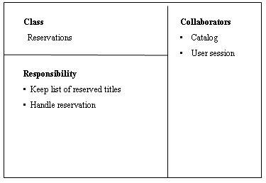
GOOD PRACTICE: CRC CARD
Class Responsibility Collaborator
easy to describe how classes work by moving cards around; allows to quickly consider alternatives.

Slide 42
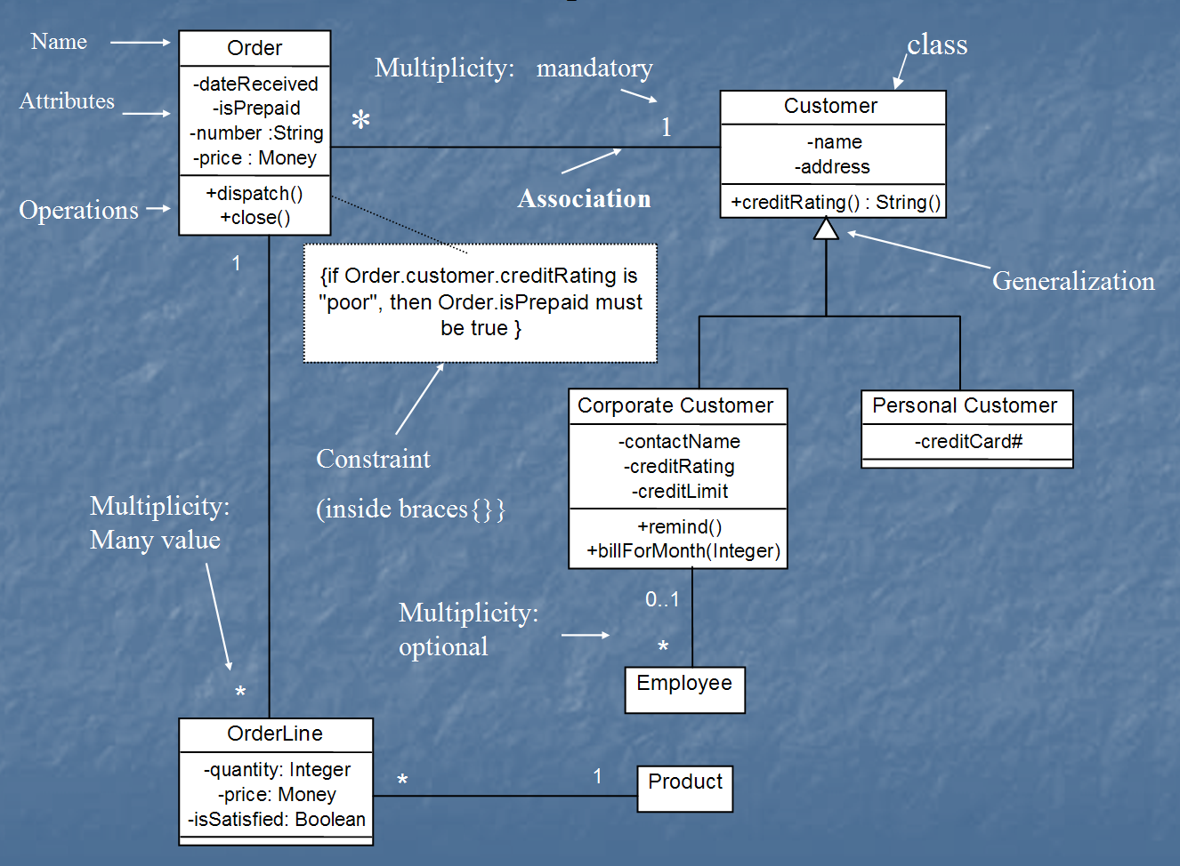
CLASS DIAGRAM
[from UML Distilled Third Edition]

Slide 43
PACKAGES
A package is a container-like element for organizing other elements into groups.
A package can contain classes and other packages and diagrams.
Packages can be used to provide controlled access between classes in different packages.
Compiler

Slide 44
PACKAGES (CONT’D)
Classes in the FrontEnd package and classes in the BackEnd package cannot access each other in this diagram.
Compiler
FrontEnd
BackEnd

Slide 45
PACKAGES (CONT’D)
Classes in the BackEnd package now have access to the classes in the FrontEnd package.
Compiler
FrontEnd
BackEnd

Slide 46
PACKAGES (CONT’D)
Compiler
We can model generalizations and dependencies between packages.
JavaCompiler
Java

Slide 47
COMPONENT DIAGRAM
Component diagrams are one of the two kinds of diagrams found in modeling the physical aspects of an object-oriented system. They show the organization and dependencies between a set of components.
Use component diagrams to model the static implementation view of a system. This involves modeling the physical things that reside on a node, such as executables, libraries, tables, files, and documents.
- The UML User Guide, Booch et. al., 1999

Slide 48
COMPONENT DIAGRAM
path.dll
collision.dll
Here’s an example of a component model of an executable release.
[Booch,99]
driver.dll
version = 8.1.3.2
IDrive
ISelfTest

Slide 49
COMPONENT DIAGRAM
signal.h
signal.h
signal.h
version = 3.5
version = 4.0
version = 4.1
“parent”
“parent”
signal.cpp
interp.cpp
version = 4.1
Modeling source code.
[Booch, 99]
irq.h
device.cpp

Slide 50
DEPLOYMENT DIAGRAM
Deployment diagrams are one of the two kinds of diagrams found in modeling the physical aspects of an object-oriented system. They show the configuration of run-time processing nodes and the components that live on them.
Use deployment diagrams to model the static deployment view of a system. This involves modeling the topology of the hardware on which the system executes.
- The UML User Guide, [Booch,99]

Slide 51
DEPLOYMENT DIAGRAM
A component is a physical unit of implementation with well-defined interfaces that is intended to be used as a replaceable part of a system. Well designed components do not depend directly on other components, but rather on interfaces that components support.
- The UML Reference Manual, [Rumbaugh,99]
component
spell-check
Dictionary
interfaces
synonyms

Slide 52
DEPLOYMENT DIAGRAM
stereotyped
<<database>>
component
Account
Transactions
Update
interface
usage dependency
component
ATM-GUI
realization dependency

Slide 53
DEPLOYMENT DIAGRAM
server:HostMachine
<<database>>
meetingsDB
Deployment diagram of a client-server system.
[Rumbaugh,99]
:Scheduler
reservations
<<direct channel>>
clientMachine:PC
:Planner

Slide 54
USE CASE
“A use case specifies the behavior of a system or a part of a system, and is a description of a set of sequences of actions, including variants, that a system performs to yield an observable result of value to an actor.”
- The UML User Guide, [Booch,99]
“An actor is an idealization of an external person, process, or thing interacting with a system, subsystem, or class. An actor characterizes the interactions that outside users may have with the system.”
- The UML Reference Manual, [Rumbaugh,99]

Slide 55
USE CASE (CONT’D)
Register for Courses
A use case is rendered as an ellipse in a use case diagram. A use case is always labeled with its name.

Slide 56
USE CASE (CONT’D)
An actor is rendered as a stick figure in a use case diagram. Each actor participates in one or more use cases.
Student

Slide 57
USE CASE (CONT’D)
Actors can participate in a generalization relation with other actors.
Student
Person

Slide 58
USE CASE (CONT’D)
Actors may be connected to use cases
only by associations.
Register for Courses
Student

Slide 59
USE CASE (CONT’D)
Here we have a Student interacting with the Registrar and the
Billing System via a “Register for Courses” use case.
Billing System
Student
Register for Courses
Registrar

Slide 60
USE-CASE DIAGRAMS
Include: a dotted line labeled <<include>> beginning at base use case and ending with an arrows pointing to the include use case. The include relationship occurs when a chunk of behavior is similar across more than one use case. Use “include” instead of copying the description of that behavior.
<<include>>
Extend: a dotted line labeled <<extend>> with an arrow toward the base case. The extending use case may add behavior to the base use case. The base class declares “extension points”.
<<extend>>

Slide 61
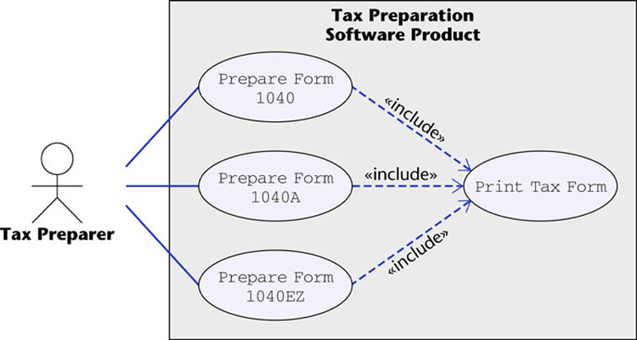
USE-CASE DIAGRAMS

Slide 62
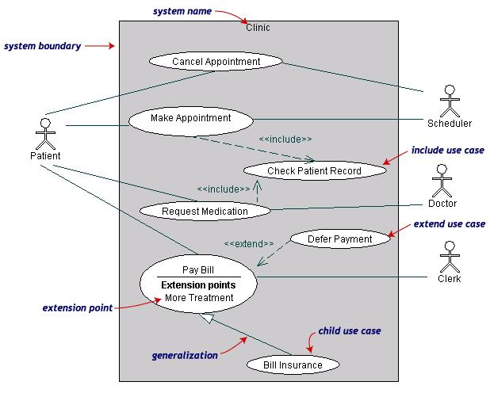
USE-CASE DIAGRAMS
Both Make Appointment and Request Medication include Check Patient Record as a subtask (include)
The extension point is written inside the base case Pay bill; the extending class Defer payment adds the behavior of this extension point. (extend)
Pay Bill is a parent use case and Bill Insurance is the child use case. (generalization)

Slide 63
STATE MACHINE
“The state machine view describes the dynamic behavior of objects over time by modeling the lifecycles of objects of each class. Each object is treated as an isolated entity that communicates with the rest of the world by detecting events and responding to them. Events represent the kinds of changes that objects can detect... Anything that can affect an object can be characterized as an event.”
- The UML Reference Manual, [Rumbaugh,99]

Slide 64
STATE MACHINE
An object must be in some specific state at any given time during its lifecycle. An object transitions from one state to another as the result of some event that affects it. You may create a state diagram for any class, collaboration, operation, or use case in a UML model .
There can be only one start state in a state diagram, but there may be many intermediate and final states.

Slide 65
STATE MACHINE
start state
final state
simple state
concurrent composite state
sequential composite state

Slide 66
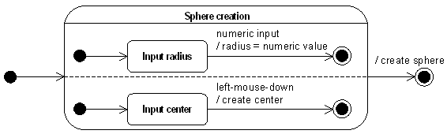
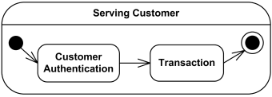
COMPOSITE STATE EXAMPLE

Slide 67
STATE DIAGRAMS (BILLING EXAMPLE)
State Diagrams show the sequences of states an object goes through during its life cycle in response to stimuli, together with its responses and actions; an abstraction of all possible behaviors.
Start
End
Unpaid
Paid
Invoice created
paying
Invoice destroying

Slide 68
STATE DIAGRAMS (TRAFFIC LIGHT EXAMPLE)
Traffic Light
Start
State
Red
Transition
Yellow timer expires
Car trips sensor
Yellow
Green timer expires
Green
Event

Slide 69
STATE MACHINE – COURSE SCHEDULING
download course offerings
downloading
unscheduled
make a course selection
selecting
make a different selection
verify selection
verifying
select another course
check schedule
sign schedule
checking schedule
scheduled

Slide 70
SEQUENCE DIAGRAM
A sequence diagram is an interaction diagram that emphasizes the time ordering of messages. It shows a set of objects and the messages sent and received by those objects.
Graphically, a sequence diagram is a table that shows objects arranged along the X axis and messages, ordered in increasing time, along the Y axis.
- The UML User Guide, [Booch,99]

Slide 71
SEQUENCE DIAGRAM
an Order Line
An object in a sequence diagram is rendered
as a box with a dashed line descending from it.
The line is called the object lifeline, and it
represents the existence of an object over a
period of time.

Slide 72
SEQUENCE DIAGRAM
an Order Line
a Stock Item
Messages are rendered as horizontal
arrows being passed from object to
object as time advances down the
object lifelines. Conditions ( such as
[check = “true”] ) indicate when a
message gets passed.
check()
[check = “true”]
remove()

Slide 73
SEQUENCE DIAGRAM
an Order Line
a Stock Item
check()
Notice that the bottom arrow is different. The arrow head is not solid, and there is no accompanying message.
This arrow indicates a return from a previous message, not a new message.
[check = “true”]
remove()

Slide 74
SEQUENCE DIAGRAM
an Order
a Order Line
* prepare()
An iteration marker, such as * (as shown), or *[i = 1..n] , indicates that a message will be repeated as indicated.
Iteration
marker

Slide 75
SEQUENCE DIAGRAM(MAKE A PHONE CALL)
Caller
Phone
Recipient
Picks up
Dial tone
Dial
Ring notification
Ring
Picks up
Hello

Slide 76
SEQUENCE DIAGRAM:OBJECT INTERACTION
A
B
Self-Call: A message that an
Object sends to itself.
Condition: indicates when a message is sent. The message is sent only if the condition is true.
Synchronous
Asynchronous
Transmission delayed
Condition
[condition] remove()
Iteration
*[for each] remove()
Self-Call

Slide 77
SEQUENCE DIAGRAMS – OBJECT LIFE SPANS
Creation
  Create message
  Object life starts at that point
Activation
  Symbolized by rectangular stripes
  Place on the lifeline where object is activated.
  Rectangle also denotes when object is deactivated.
Deletion
  Placing an ‘X’ on lifeline
  Object’s life ends at that point
A
Create
B
Activation bar
X
Return
Deletion
Lifeline

Slide 78
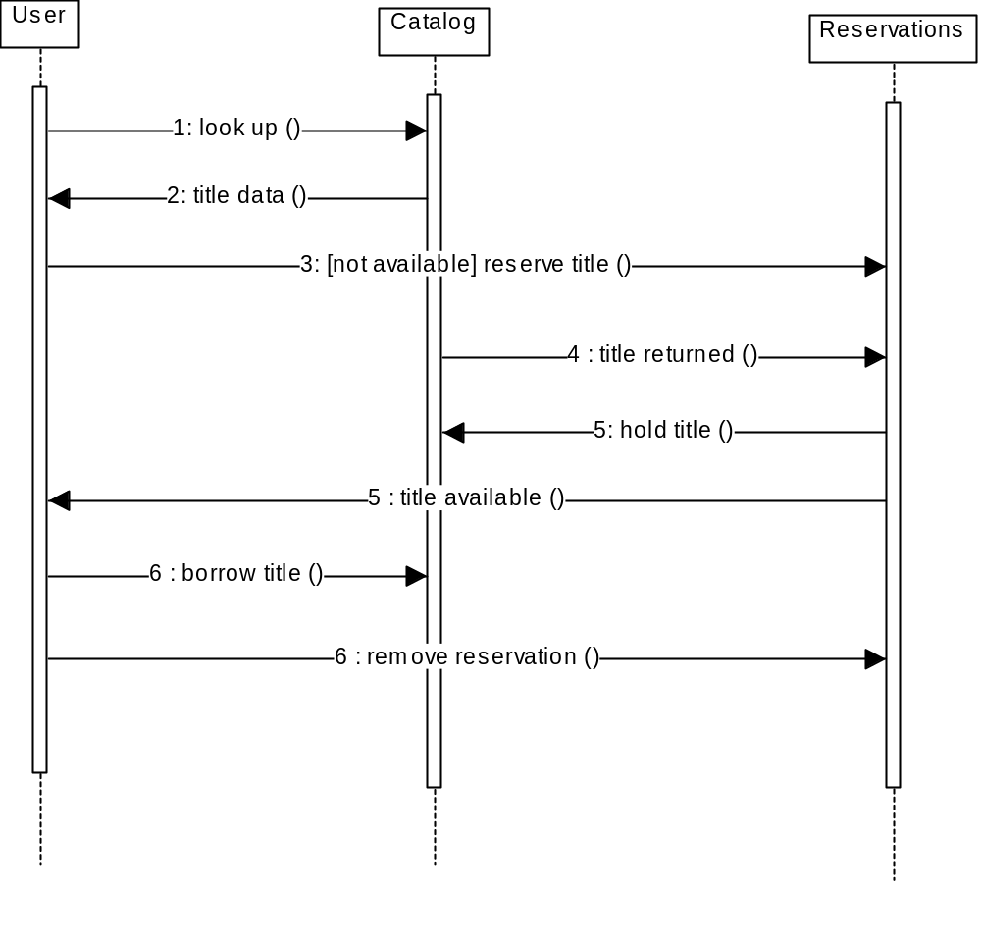
SEQUENCE DIAGRAM
Message
Sequence diagrams demonstrate the behavior of objects in a use case by describing the objects and the messages they pass.
The horizontal dimension shows the objects participating in the interaction.
The vertical arrangement of messages indicates their order.
The labels may contain the seq. # to indicate concurrency.

Slide 79
an Order Entry
window
an Order
an Order Line
a Stock Item
[Fowler,97]
prepare()
Condition
* prepare()
Object
check()
Message
[check = “true”]
remove()
needsToReorder()
Iteration
Return
Self-Delegation
[needsToReorder = “true”]
new
A Reorder
Item
[check = “true”]
new
A Delivery
Item
Creation

Slide 80
COLLABORATION DIAGRAM
A collaboration diagram emphasizes the relationship of the objects that participate in an interaction. Unlike a sequence diagram, you don’t have to show the lifeline of an object explicitly in a collaboration diagram. The sequence of events are indicated by sequence numbers preceding messages.
Object identifiers are of the form objectName : className, and either the objectName or the className can be omitted, and the placement of the colon indicates either an objectName: , or a :className.

Slide 81
COLLABORATION DIAGRAM
: Order Entry Window
Object
Sequence Number
1: prepare()
Message
: Order
Self-Delegation
5: needToReorder()
2*: prepare()
3: check()
4: [check == true] remove()
: Order Line
: Stock Item
7: [check == true] new
6: new
:Delivery Item
:Reorder Item
[Fowler,97]

Slide 82
INTERACTION DIAGRAMS: COLLABORATION DIAGRAMS
start
6: remove reservation
3 : [not available] reserve title
User
Reservations
6 : borrow title
5: title available
2: title data
1: look up
4 : title returned
Catalog
5 : hold title
Both a collaboration diagram and a sequence diagram derive from the same information in the UML’s metamodel, so you can take a diagram in one form and convert it into the other. They are semantically equivalent.
Use a sequence diagram when the transfer of information is the focus of attention
Use a collaboration diagram when concentrating on the classes

Slide 83
ACTIVITY DIAGRAM
An activity diagram is essentially a flowchart, showing the flow of control from activity to activity.
Use activity diagrams to specify, construct, and document the dynamics of a society of objects, or to model the flow of control of an operation. Whereas interaction diagrams emphasize the flow of control from object to object, activity diagrams emphasize the flow of control from activity to activity. An activity is an ongoing non-atomic execution within a state machine.
- The UML User Guide, [Booch,99]

Slide 84
Receive
[Fowler,97]
Order
Multiple Trigger
*
for each line
item on order
Cancel
Authorize
Check
Order
Payment
Line
[failed]
Item
[succeeded]
[in stock]
Assign to
Order
Synchronization Condition
[need to
reorder]
Reorder
[stock assigned to
Item
all line items and
payment authorized]
Dispatch
Order

Slide 85
SOME REFERENCES
https://www.cs.drexel.edu/~spiros/teaching/CS575/slides/uml.ppt
https://www.cs.ucf.edu/~turgut/COURSES/EEL5881_SEI_Fall07/UML_Lecture.ppt
Booch, Grady, James Rumbaugh, Ivar Jacobson,
The Unified Modeling Language User Guide, Addison Wesley, 1999
Rumbaugh, James, Ivar Jacobson, Grady Booch, The Unified
Modeling Language Reference Manual, Addison Wesley, 1999
Jacobson, Ivar, Grady Booch, James Rumbaugh, The Unified
Software Development Process, Addison Wesley, 1999
Fowler, Martin, Kendall Scott, UML Distilled (Applying the Standard Object Modeling Language), Addison Wesley, 1997.

